Slide 1
Advanced Pentaho Data Integration
James O’Reilly

Slide 2
Agenda
Metadata Injection
PDI as a Data Source
Data Streaming
Scalability
Project Management

Slide 3
Pentaho Data Integration Metadata Injection
James O’Reilly

Slide 4
Agenda
Overview Metadata Injection
Standard MDI
Push – Pull MDI
2 - Phase
Filters

Slide 5
Overview of Metadata Injection

Slide 6
Overview of Metadata Injection
Metadata injection refers to the dynamic passing of metadata to PDI transformations at run time in order to control complex data integration logic.
The metadata (from the data source, a user defined file, or an end user request) can be injected on the fly into a transformation template, providing the “instructions” to generate actual transformations.
This enables teams to drive hundreds of data ingestion and preparation processes through just a few actual transformations, heavily accelerating time to data insights and monetization.

Slide 7
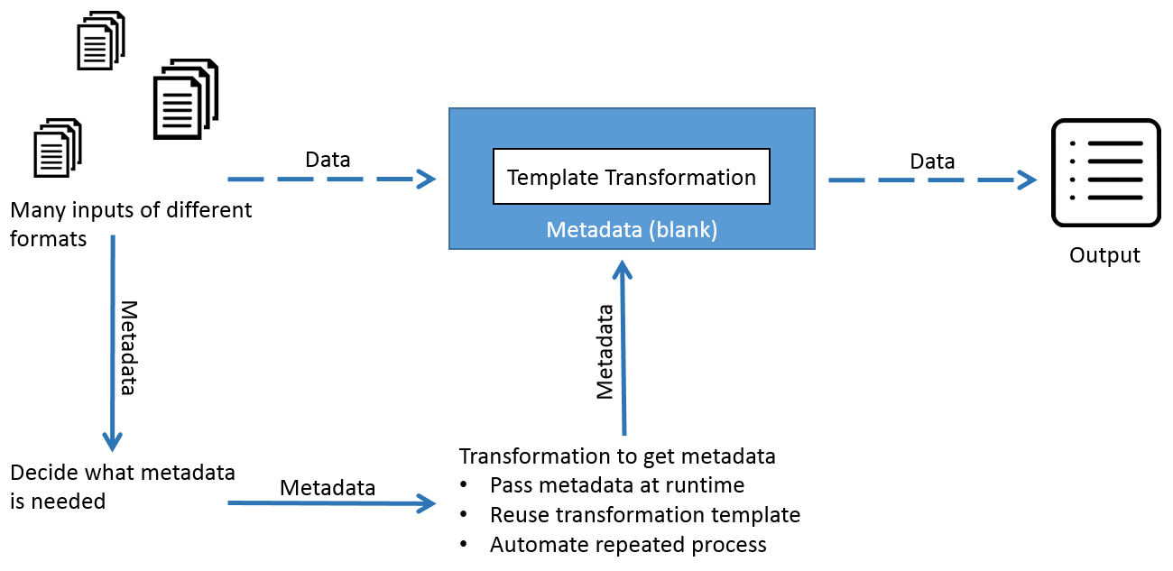

Overview of Metadata Injection
The ETL Metadata Injection step inserts metadata into a template transformation

Slide 8
Overview of Metadata Injection
When is Metadata Injection useful?
There is a repeatable processing pattern.
Where the variations between the data sources are within the scope of the step.
Is applicable to a large number of transformations.
That often have dynamic source(s) and/or target(s).

Slide 9
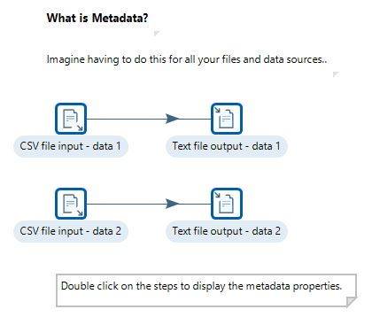
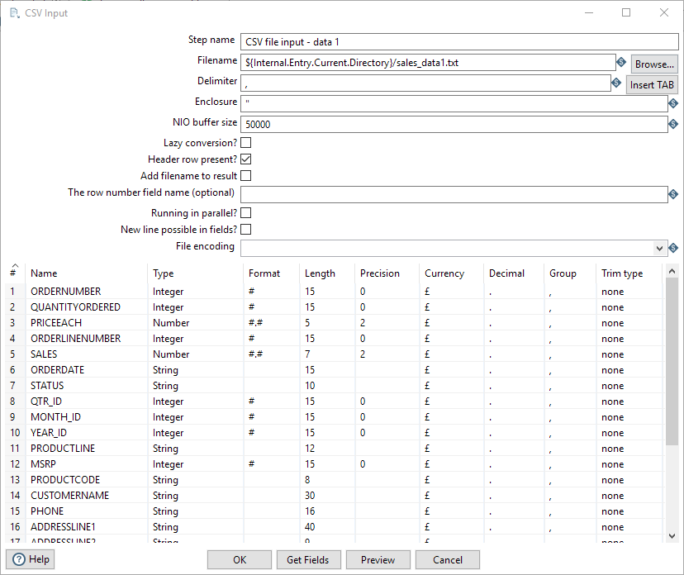
Demonstration – Metadata Injection
What is Metadata?
Imagine having to do this for all your files and data sources.

Slide 10
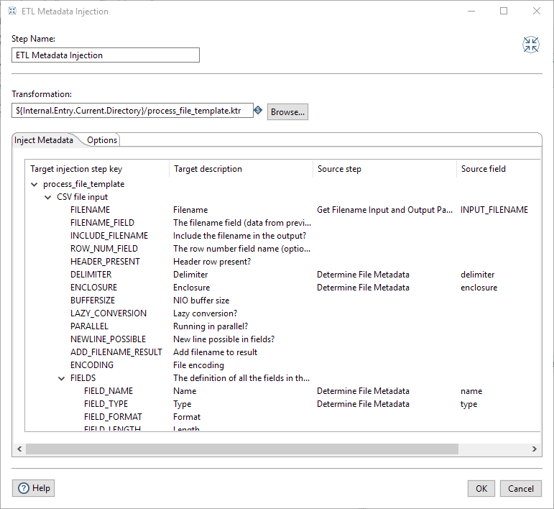
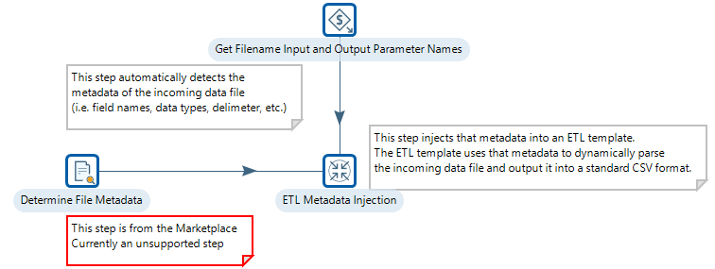
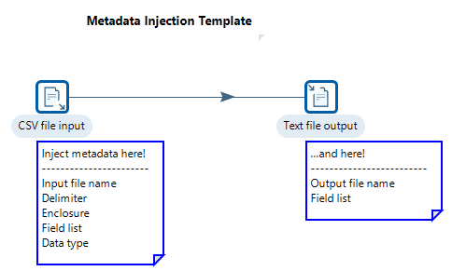
Demonstration – Metadata Injection
Dynamic Metadata Injection
This transformation takes two parameters:
p_input_filename: default value points to a ”sales_data1.txt” file
p_output_filename: default value outputs a file called “dynamic_output1.csv”
Metadata Injection Template

Slide 11
Standard Metadata Injection

Slide 12
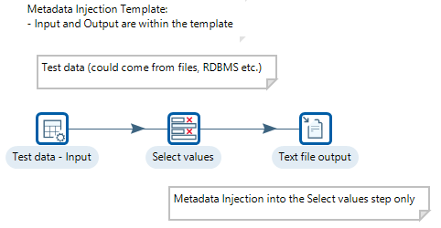
Guided Demo: Standard Metadata Injection
Template has test data
Metadata injected into Select Values step

Slide 13
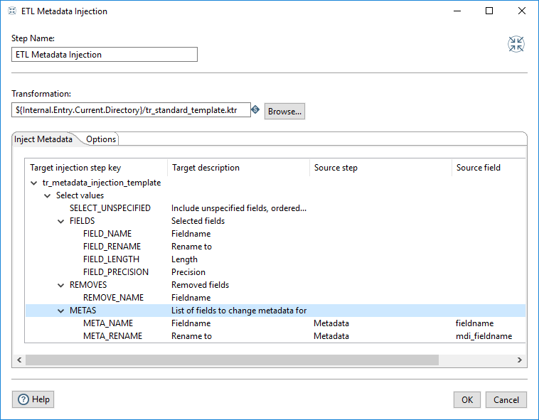
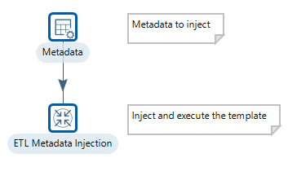
Guided Demo: Standard Metadata Injection
ETL Metadata step injects the ‘referenced’ metadata properties

Slide 14
Metadata Injection Scenarios

Slide 15
Metadata Scenarios
Push or Pull & combined Push - Pull
2-Phase
Filters
Retail

Slide 16
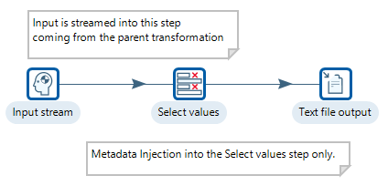
Guided Demo: Push Metadata Injection
The ETL Metadata Injection step needs to reference the ‘Input stream step’ of the template.
The datastream is streamed / pushed from ‘Test Data step’ to the ‘Input stream’.
Metadata properties injected into
Select values step.

Slide 17
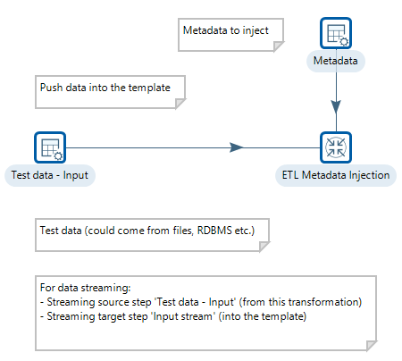
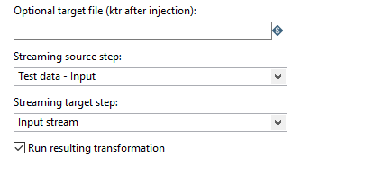
Guided Demo: Push Metadata Injection
ETL Metadata step references the Input stream step in the template

Slide 18
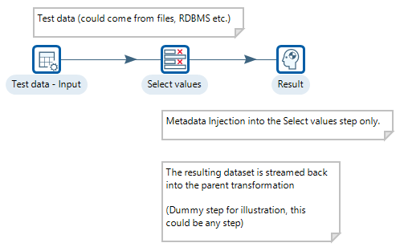
Guided Demo: Pull Metadata Injection
The ETL Metadata Injection step needs to reference the ‘Result step’ of the template.
The datastream is streamed / pulled from ‘Result step’ to the ‘ETL Metadata Transformation’.
Metadata properties injected into
Select values step.

Slide 19
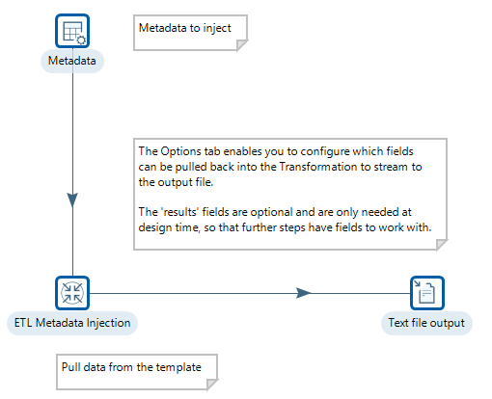
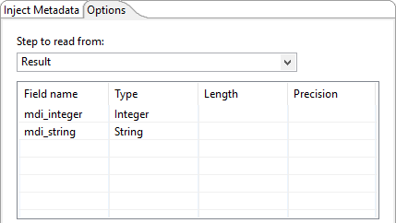
Guided Demo: Pull Metadata Injection
ETL Metadata Injection step references the Result step in the template, along with the required fields.

Slide 20
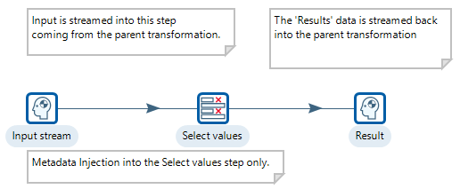
Exercise: Push / Pull Metadata Injection
Dataset is streamed to (push) and from (pull) the template
Metadata properties injected into
Select values step.

Slide 21
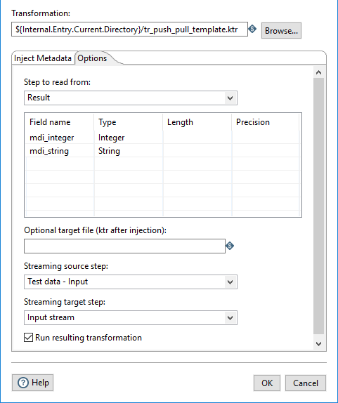
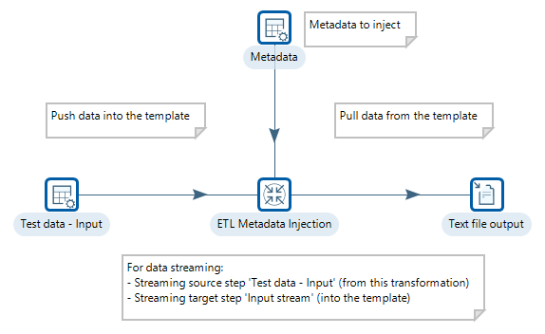
Exercise: Push / Pull Metadata Injection
ETL Metadata Injection step references both the Input stream and Result steps in the template, along with the required fields, to push and stream back the dataset.

Slide 22
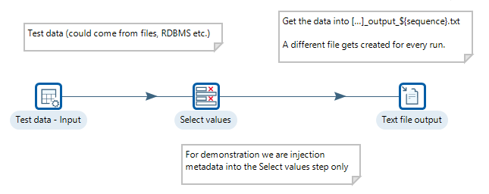
Exercise: 2-phase Metadata Injection
Phase 1 – template
The text file output will create a new set of ‘sequenced files’ to indicate how in Phase 2 the output Transformation can used in other KTRs.

Slide 23
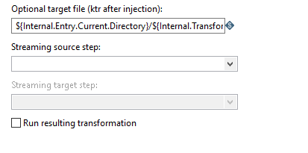
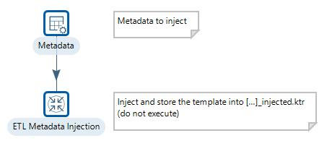
Exercise: 2-phase Metadata Injection
In Phase 1 – the injected metadata properties are ‘stored’ in an output Transformation _injected.ktr

Slide 24
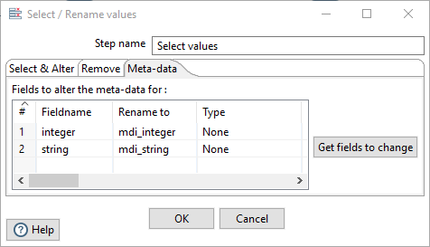
Exercise: 2-phase Metadata Injection
The output is a Transformation: tr_2_phase_mdi_injected.ktr
Open the Transformation. The Transformation has been populated with the injected Metadata properties.
Double-click on Select Values step.

Slide 25
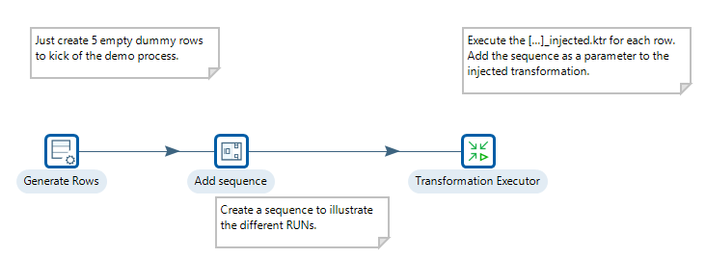
Exercise: 2-phase Metadata Injection
In Phase 2 – the _injected.ktr is looped (5 times) with a Transformation Executor step.

Slide 26
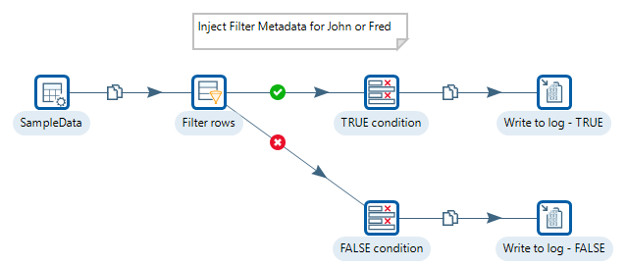
Exercise: Filters
Another example of a 2 phase MDI. Injecting Metadata to filter for John and Fred

Slide 27
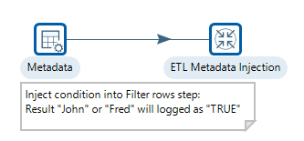
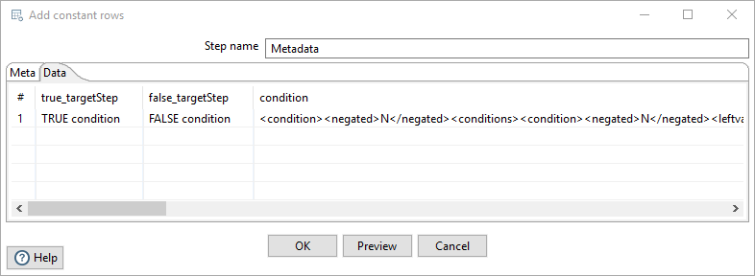
Exercise: Filters
Double-click on the Metadata step > Data tab for the condition in the main ETL Metadata Transformation.
The condition is defined in the step xml

Slide 28
Exercise: Filters
Open the Test filter template and copy and paste the Filter step into Notepad++
Filter defined between lines: 18 -35
Copy to condition to Metadata step
<condition>
<negated>N</negated>
<conditions>
<condition>
<negated>N</negated>
<leftvalue>Name</leftvalue>
<function>=</function>
<rightvalue/>

Slide 29
Retail Sales

Slide 30
Exercise: Retail Sales
Stock and Sales data from Retail Stores arrive in different formats.
Using Transformation Executor, you can dynamically inject metadata into a template that will standardise the output..

Slide 31
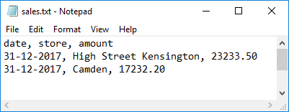
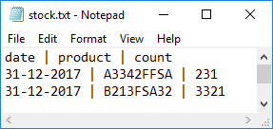
Sales and Stock data
Sales data - values delimited with a comma
Stock data – values delimited with |

Slide 32

Stores data
The objective is to append the data into a standard format..
Don’t focus on the data .. The objective here is to demonstrate how metadata injection can help..
Stores data - delimited with semi colon

Slide 33
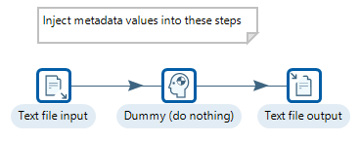
Template
The template provides the ETL workflow appending the two data sources (sales & stock).

Slide 34
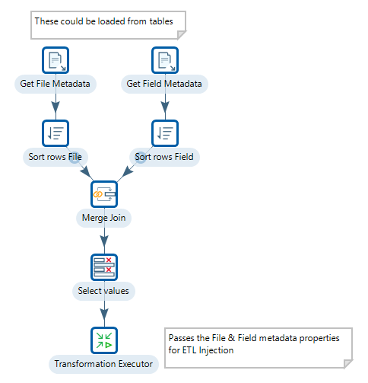
Master Transformation
Master Transformation loads the file and metadata properties and sends the group of records relevant for each input file to the Metadata Injection Transformation.

Slide 35
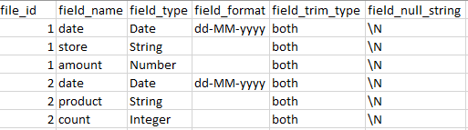
File Metadata Properties
First load the required file and field metadata properties:
File
Field
Each file (sales and stock) has
a unique file_id

Slide 36
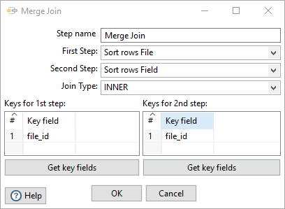
Sorted then Joined
File and Field Metadata properties are set by joining on file_id
As these are fields in the datastream,
PDI will ask you to sort. (on file_id)

Slide 37
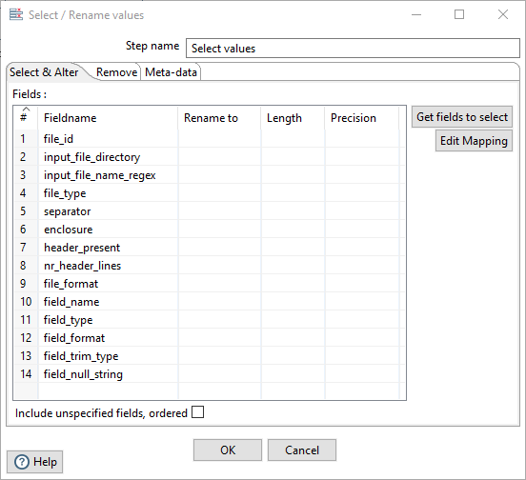
Select Field and Metadata Properties
Select the required metadata properties to apply to each Sales and Stock datasource.

Slide 38
Transformation Executor

Slide 39
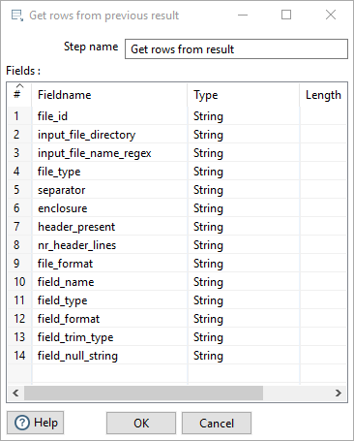
Transformation Executor
Overall objective is to set the required injected metadata properties for each datasource (Sales and Stock).
The metadata properties are grouped by: file_id
Using a Transformation Executor step enables you to set the file and field metadata properties.
First ‘load’ all the metadata properties.
*Copy Fields from the Select values step*

Slide 40
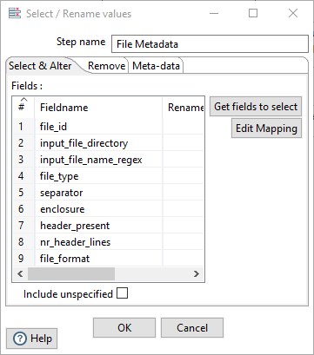
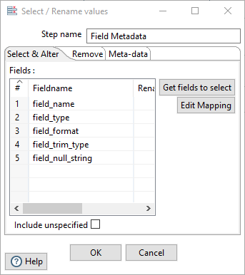
Select File and Field Metadata Properties
The metadata properties have to be ‘split’ into file and field so that they can be applied to each datasource (Sales and Stock).

Slide 41
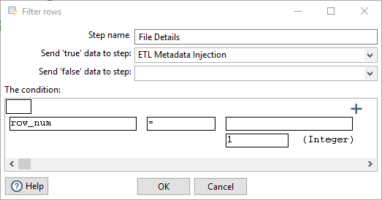
Sequence
As the metadata properties have been grouped by file_id, there’s no need to loop through i.e repeat the workflow.
A sequence is added to filter for the first set of standard file metadata properties.

Slide 42
ETL Metadata Injection
OK so we’re now ready to inject both the file and field metadata properties
TARGET | SOURCE STEP | SOURCE FIELD
Text file input
FILE_TYPE | File Details | file_type
SEPARATOR | File Details | separator
ENCLOSURE | File Details | enclosure
HEADER_PRESENT | File Details | header_present
NR_HEADER_LINES | File Details | nr_header_lines
FILE_FORMAT | File Details | file_format
FILENAME_LINES
FILENAME | File Details | input_file_directory
FILEMASK | File Details | input_file_name_regex
FIELDS
FIELD_NAME | Field Metadata | field_name
FIELD_FORMAT | Field Metadata | field_format
FIELD_NULL_STRING | Field Metadata | field_null_string
FIELD_TYPE | Field Metadata | field_type
FIELD_TRIM_TYPE | Field Metadata | field_trim_type

Slide 43
Summary
Push or Pull & combined Push - Pull
2-Phase
Filters
Retail

Slide 44
Thank You

